Slide 1
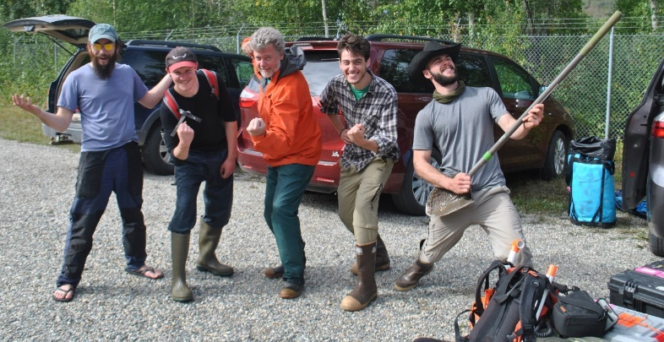
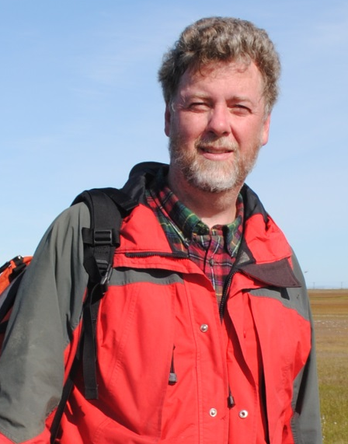
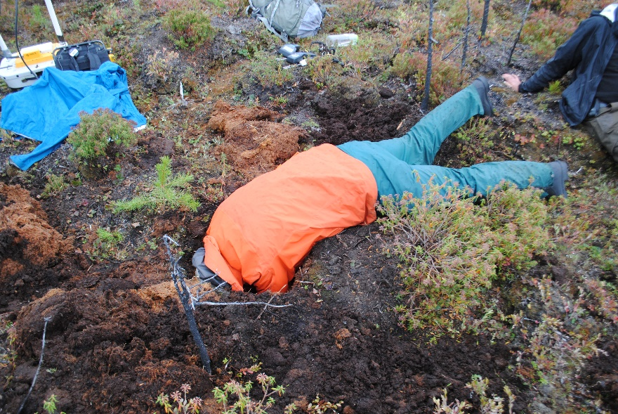
Carbon Emissions from Thawing Permafrost
Kevin Schaefer
National Snow and Ice Data Center

Slide 2
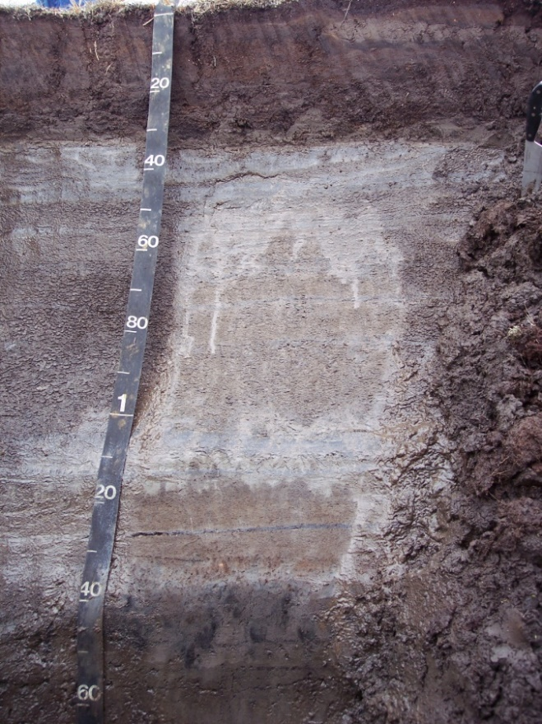
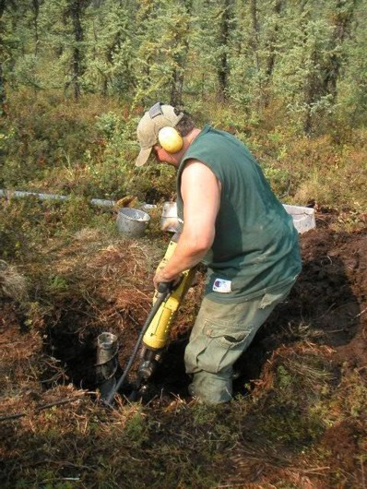
Permafrost
Active Layer
Siberia, Russia
Permafrost
Permafrost is like concrete

Slide 3
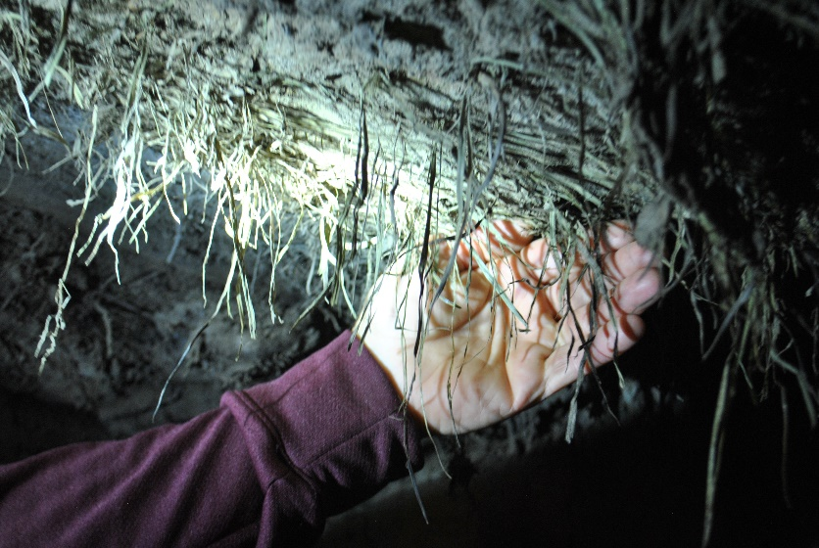
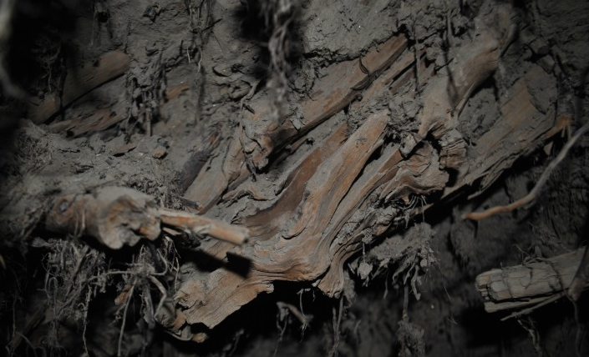
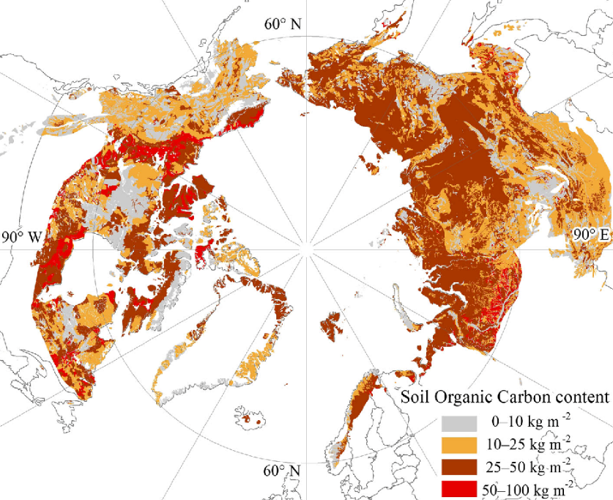
CO₂ from Thawing Permafrost
32,000 year old grass, Alaska
30,000 year old wood, Alaska
Warming: 0.29±0.21 °C by 2100
~8% of Anthropogenic Warming

Slide 4
Climate Change Opportunities
Economic Growth!
American Industry!
American Jobs!

Slide 5
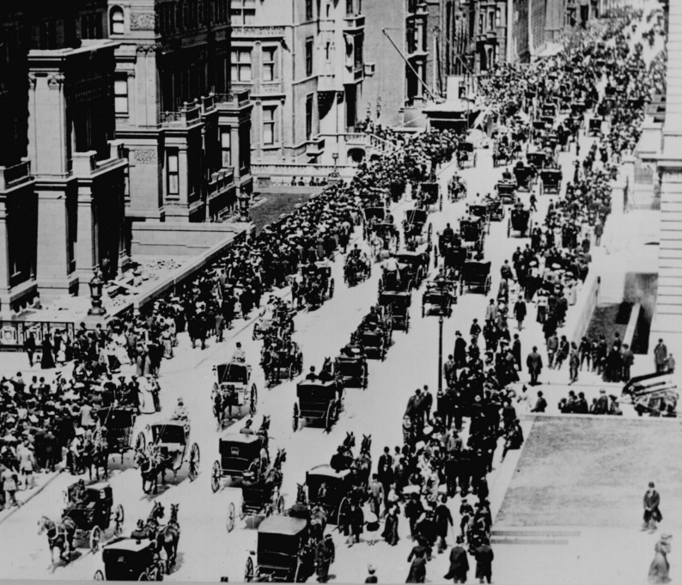

Economic Tipping Points
Shift in purchasing patterns driven by cost
Example: Cars in New York City
NYC 5th Ave 1900
NYC 5th Ave 1920

Slide 6
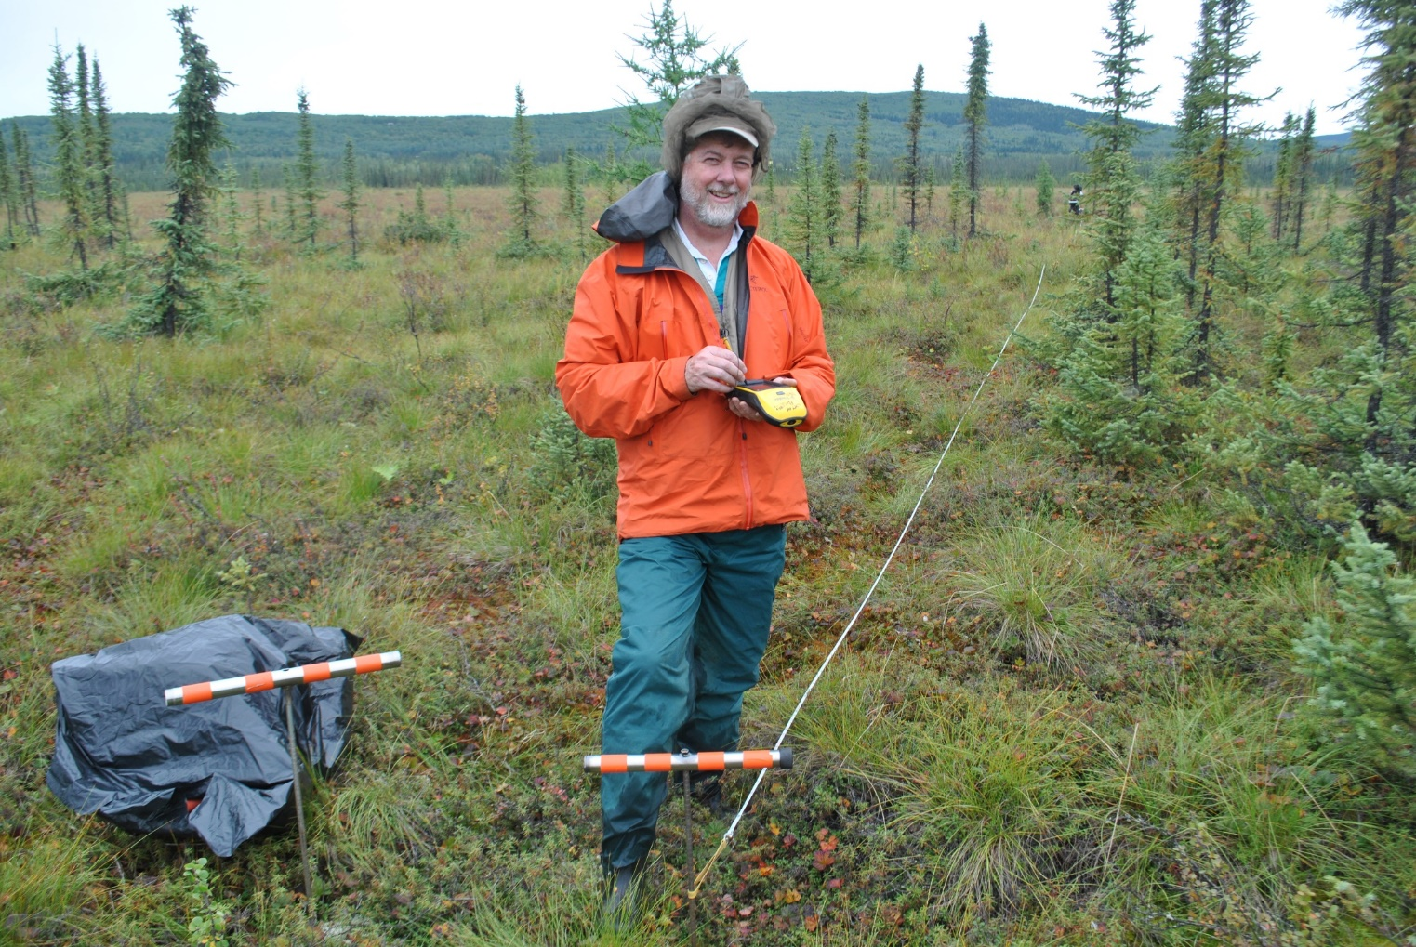
Thank You
Alaska 2018

