Slide 1

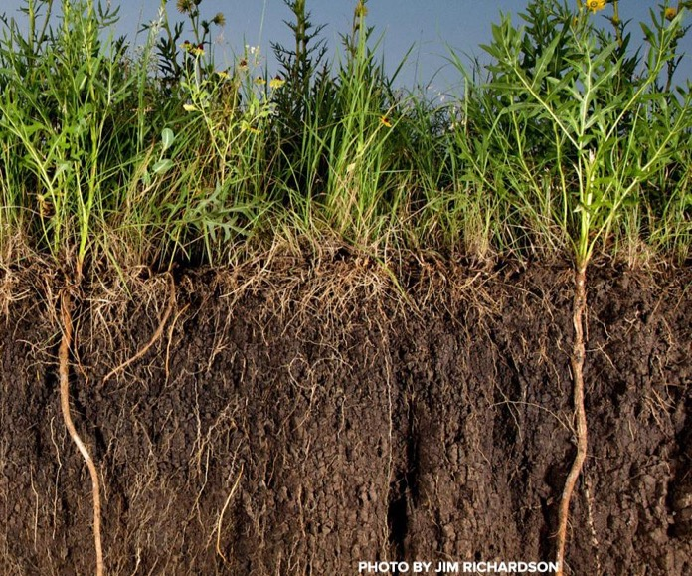
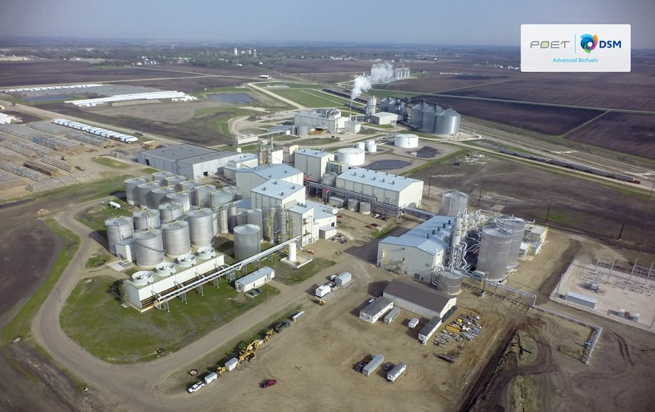
Biochar, carbon-negative bioenergy & soils
John Field
Natural Resource Ecology Laboratory,
Colorado State University
SEJ 29th Annual Conference
Fort Collins, CO
Oct. 12, 2019

Slide 2
Negative emissions / CDR / Drawdown
More Technology
More Land
Mercator Research Institute on Global Commons and Climate Change
MCC Policy Brief No. 2 – November 2016
Deliberate enhancement of natural carbon sinks, and/or creation of new artificial ones
Land/photosynthesis-based solutions grow organic matter (biomass) for ecosystem sequestration, or as feedstock

Slide 3
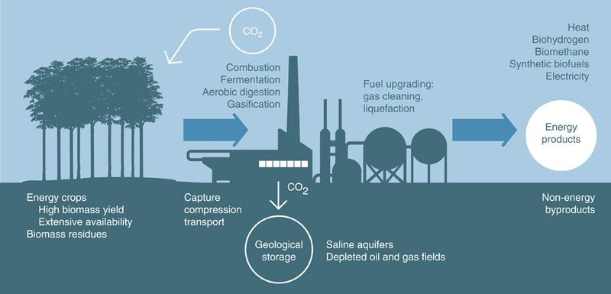
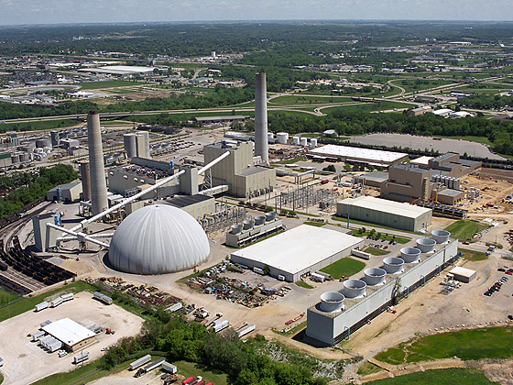
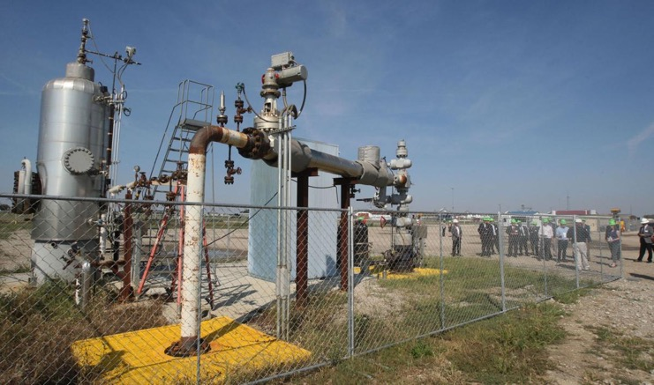
BioEnergy w/ Carbon Capture & Storage
ADM ethanol plant in Decatur IL
Illinois Industrial CCS Project

Slide 4
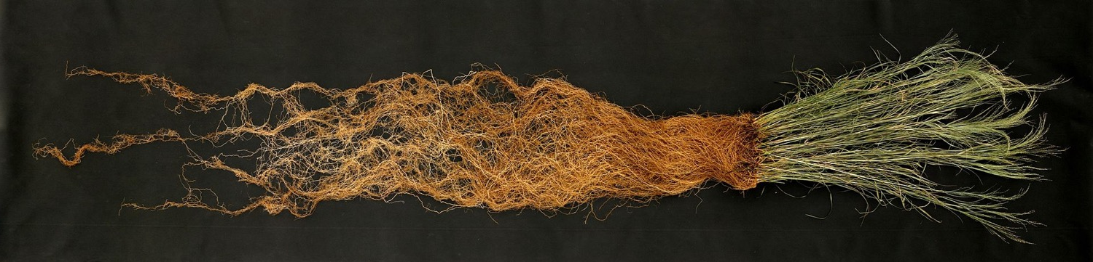
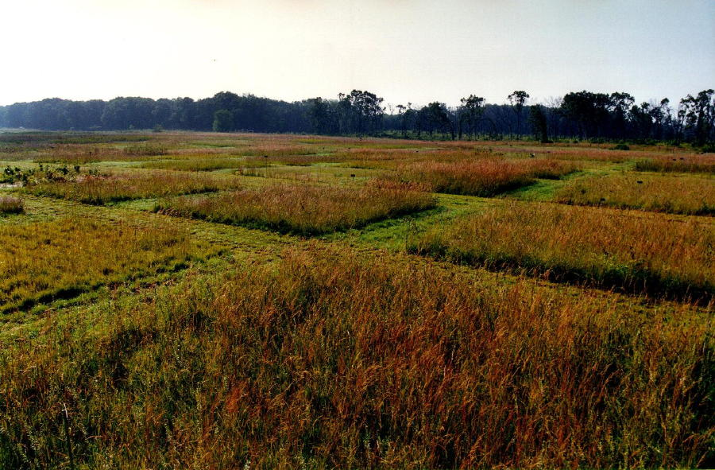
Perennial feedstocks more sustainable
Cedar Creek Ecosystem Science Reserve, MN
Longer growing season
More carbon into roots
Less fertilizer, tillage
Less erosion

Slide 5
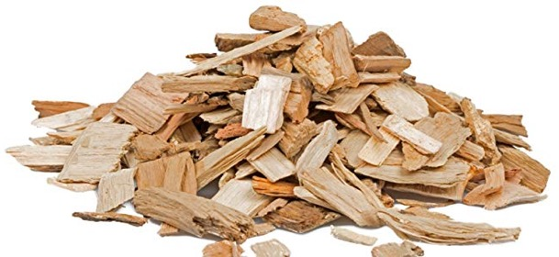
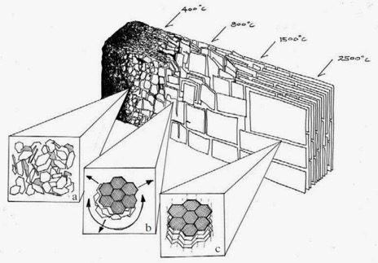
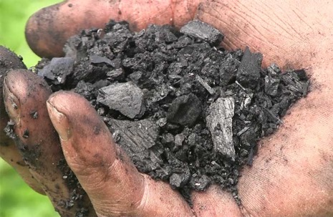
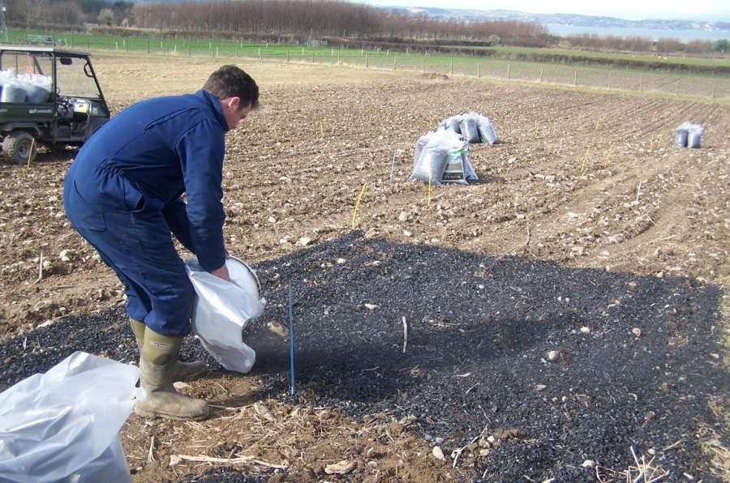
Biochar as a BECCS alternative
https://www.bangor.ac.uk/natural-sciences/research/environment-natural-resources-and-geography/facilities/henfaes_biochar.php.en

Slide 6

Summer conference in Fort Collins!

Slide 7
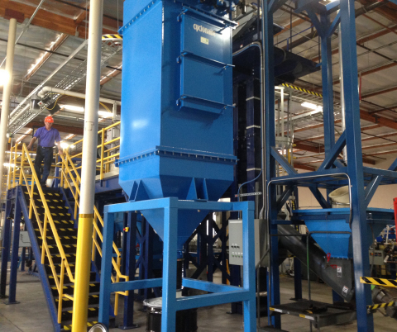
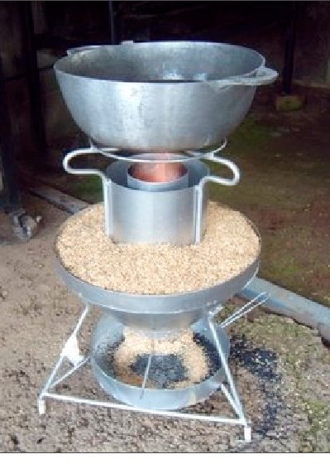
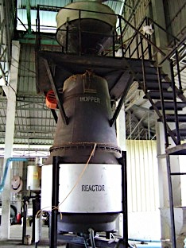
Biochar as an ‘appropriate technology’?
Cool Planet, Camarillo CA
Rice husk gasifier stove, Philippines
SME Renewables, Cambodia

Slide 8
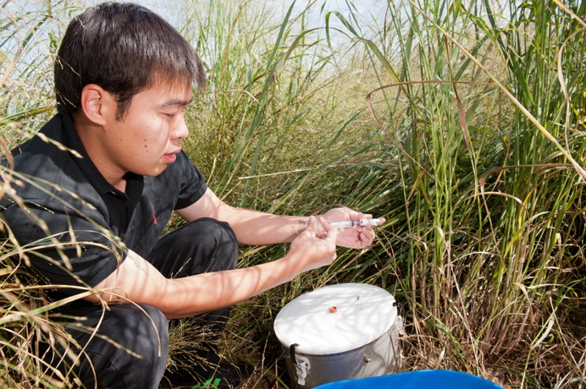
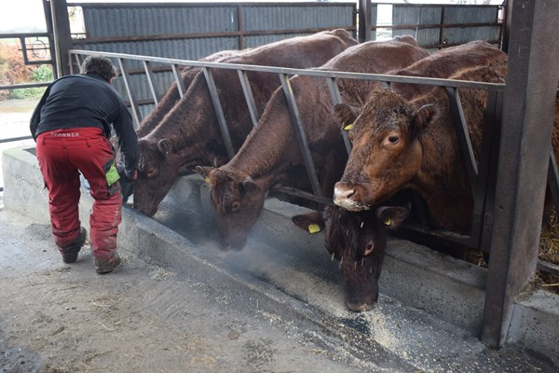
Biochar soil benefits
Carbon sequestration
Affects soil water holding capacity, pH, ability to hold on to nutrients
Yield benefits
  13% observed by Cool Planet
N₂O emission reduction
  20–40% seen in meta-analyses
Use in animal feed
  Health improvements, enteric methane reductions
Photo Credit: K.Stepnitz, Michigan State University (https://lter.kbs.msu.edu/ngg_tag/colleting-data/)
(https://www.innovativefarmers.org/news/2019/march/19/is-biochar-a-wonder-material-only-farmer-led-science-will-tell/)

Slide 9





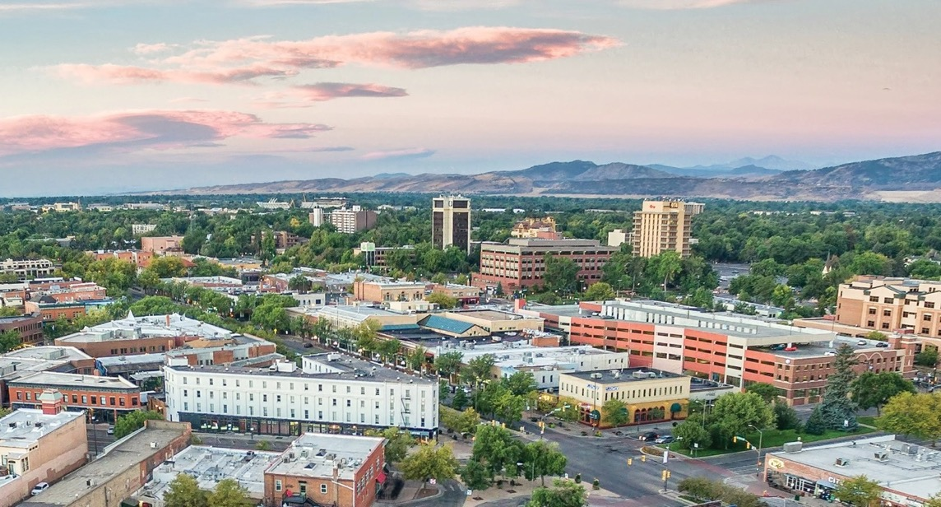
Thank you!
Email: John.L.Field@gmail.com
Notes:
Laboratory and pilot scale operations in Camarillo, CA, commercial-scale facility being designed for Alexandria, LA. Organic Materials Review Institute. CA Dept of Food and Agriculture.

